Slide 1
Harvest Time Alert

Slide 2
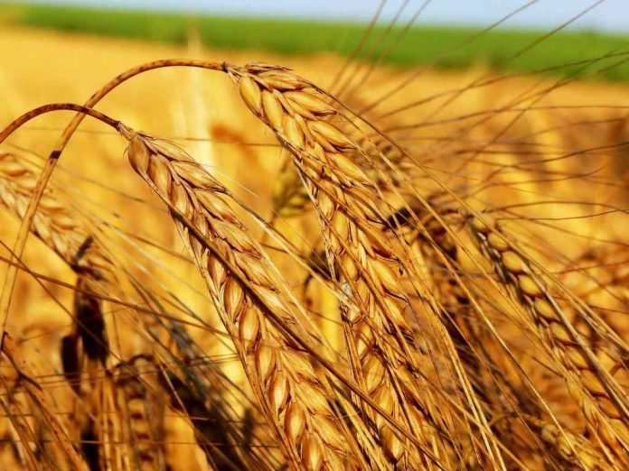
Purposes
Other Studies
Difficulties
Results
Suggestions
Content

Slide 3
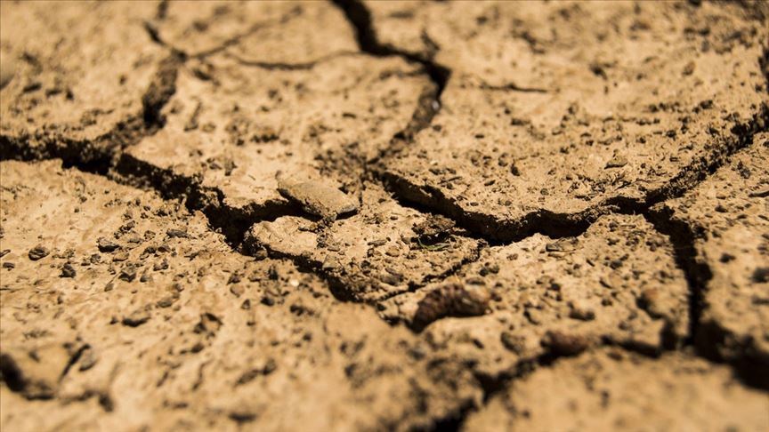
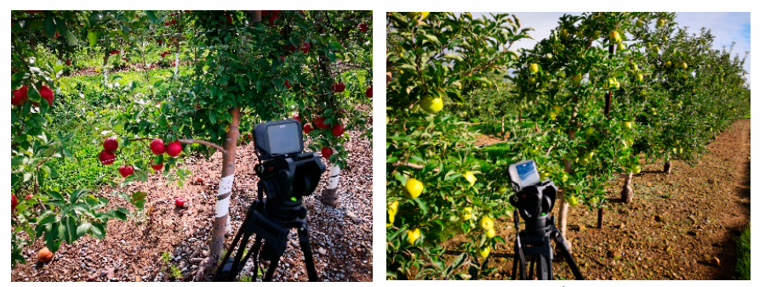
Purposes
Our aim is to create a program that informs the harvest time of the photos taken with a camera set up in a garden, by subjecting them to some processes in the system.

Slide 4
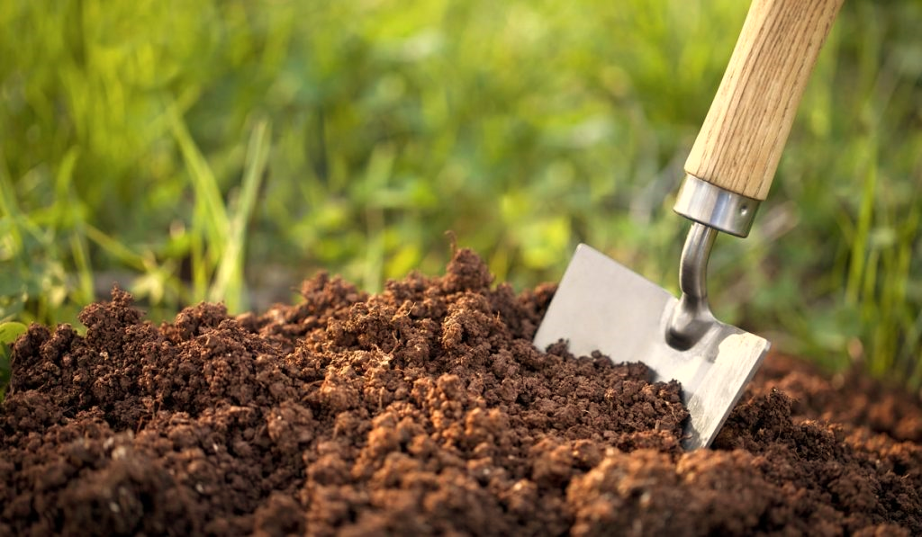
Other Studies
Kondo conducted a research on the location of the fruit with the robotic vision method he had done in 1988. In this research, it was stated that a stereo camera would be used to find relatively low plants such as tomatoes. It has been seen that the process of recognizing the fruits of tall trees and measuring their location accurately is difficult. It has been determined that the reason for this is that the sensor is at a longer distance from the fruits.

Slide 5

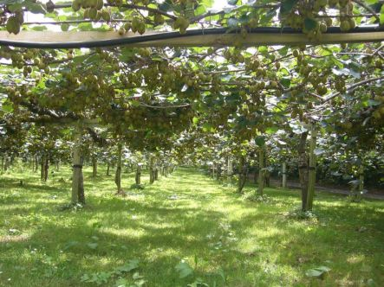
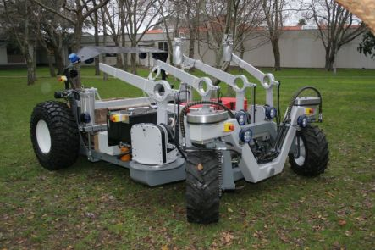
Flemmer et al. aimed at remote controlled kiwi harvest in the design they made in 2007 . With this design, they were able to collect 14,000 kiwis per hour. After taking the image with the camera system attached to the arms of the robot and processing it, they defined the fruit as. They harvested the fruit by rotating the fruit on its own axis according to the fruit firmness determined as a result of the hardness measurement and by means of arms with 360 degree mobility.

Slide 6
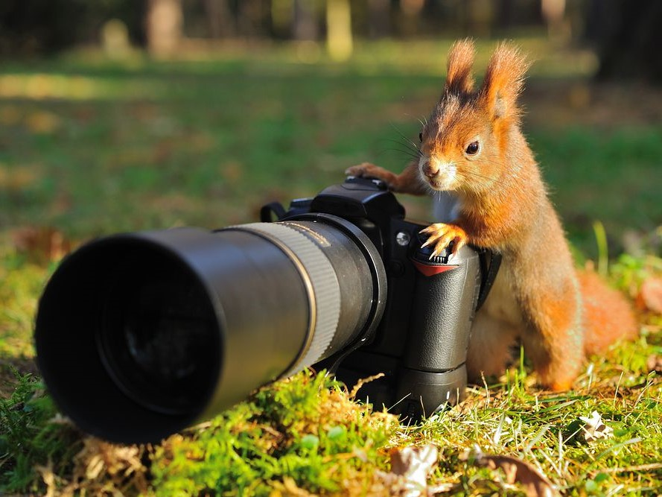
Diffuculties
-Effect of light on photography
-Shooting angle of the camera
-Code fallacy of non-product factors

Slide 7
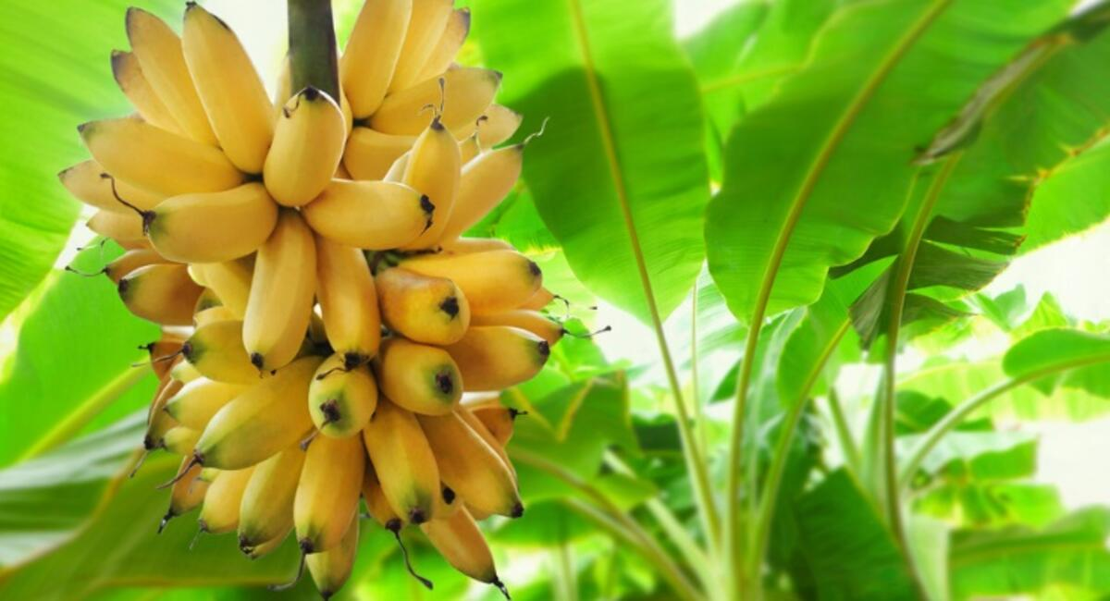
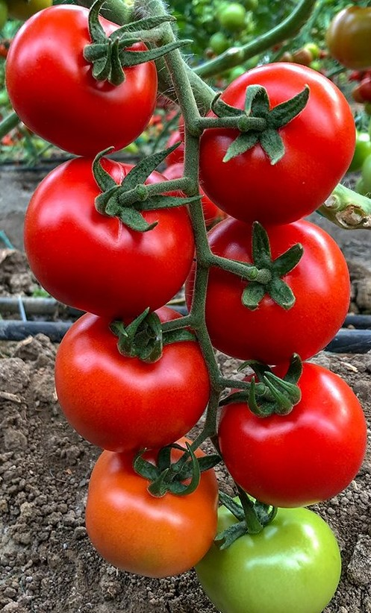
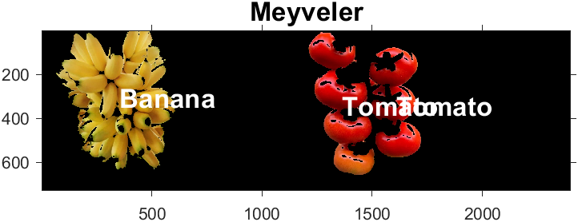
Results
We passed the pictures taken by the camera through the image processing stages and obtained a printout about the type of product.

Slide 8
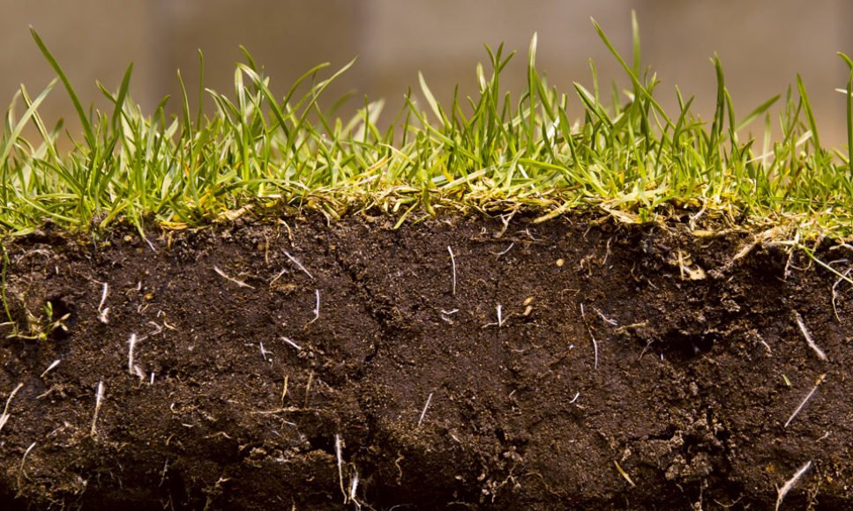
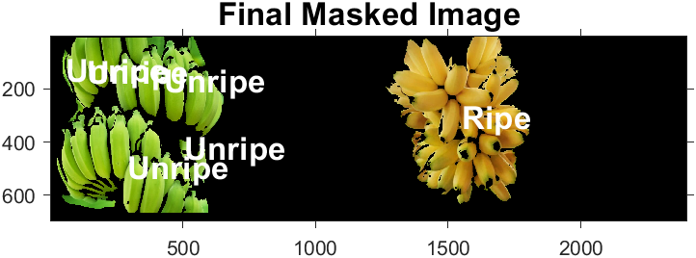
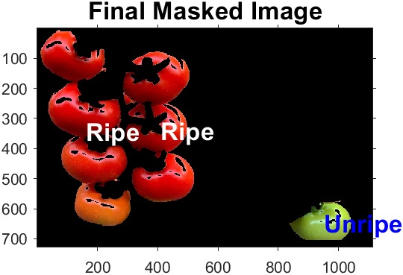

In line with the resulting output, the maturity decision was made according to the color of the fruit and vegetable and it was printed on the screen.
Unripe

Slide 9
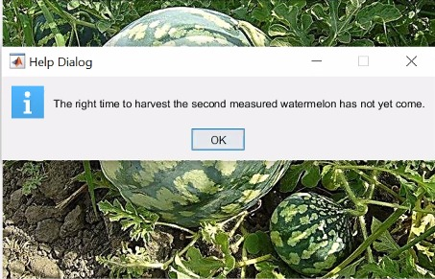
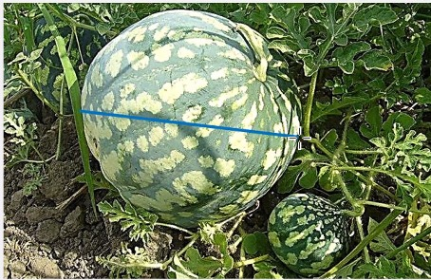
We made a maturity determination according to the diameter for the products whose diameter largely depends on whether they are ripe or not.

Slide 10
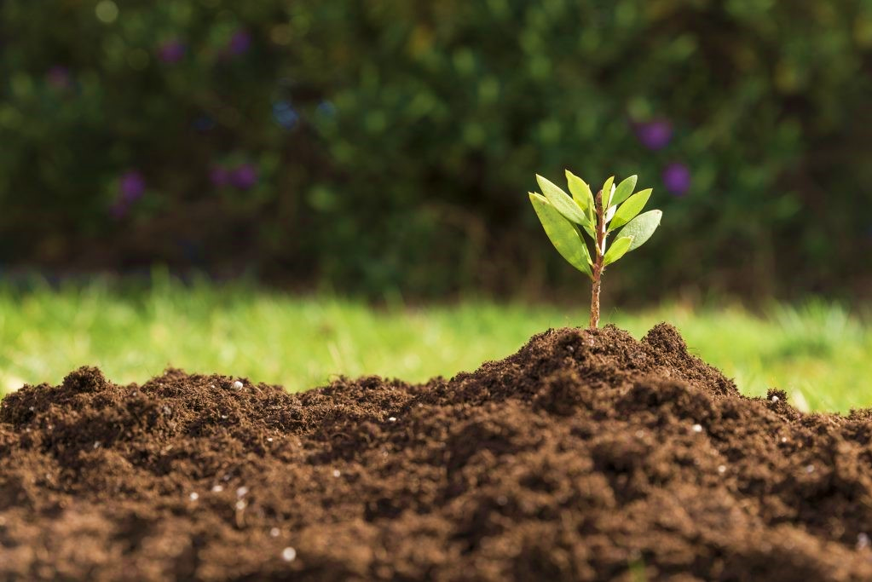
Suggestions
-Light Effect
-Hayashi (2010)
-For fruits and vegetables with the same color, the difference in color, size, shape and texture is high
-Minimizing the deception of non-plant elements such as leaves, soil and branches in the plant
-Adding automatic product counting feature etc.

Slide 11
THANKS FOR LISTENING.
AYSU ARDA
ZEYNEP AKKOÇ

